Slide 1
SQL Project
Sub : DATA ANAYSIS OLYMPIC DATA BY USING SQL QUERY
By : Sapana .Gayakwad

Slide 2

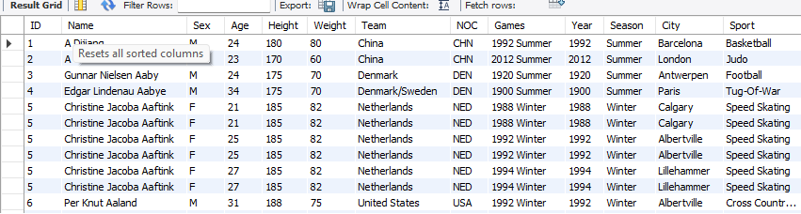
1.Data base create and import table
-- SQL PROJECT
create database project1;
use project1;
show tables;
select * from olympic;

Slide 3
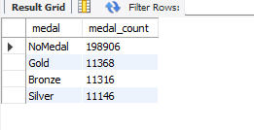
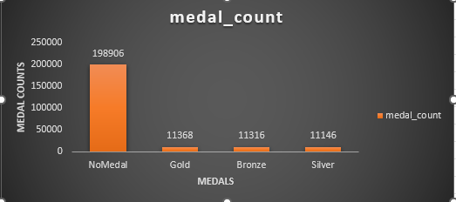
-- 1. Show how many medal counts present for entire data
select medal,count(*) as medal_count from olympicgroup by medal;
Output:
counts

Slide 4
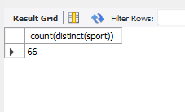
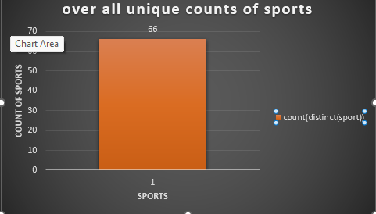
-- 2. Show count of unique sports present in Olympics
select count(distinct(sport)) from olympic;
Query Result using sql
Data visualization By Graph

Slide 5
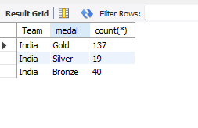
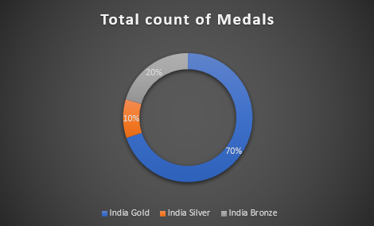
-- 3. Show how many different medals won by team India
select Team , medal , count(*) from Olympic
where team="India" and Medal!="NoMedal“
group by Team,Medal;

Slide 6
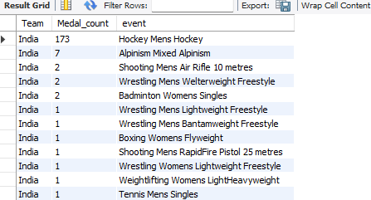
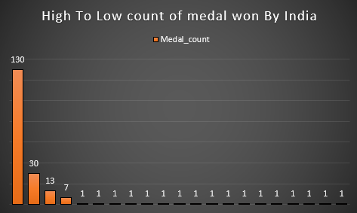
-- 4. Show event wise medals won by India show from highest to lowest medals won in order
select Team ,count (Medal) as Medal_count ,event from Olympic
where (Team= 'India' and medal!= 'NoMedal’ )
group by Event
order by Medal_count asc;

Slide 7
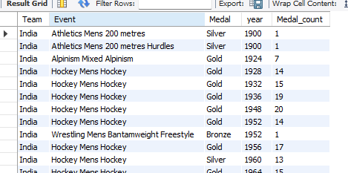
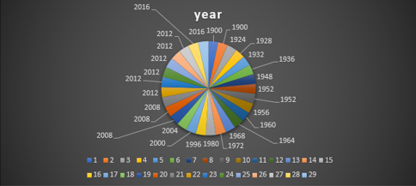
-- 5. Show event wise medals won by India in order of year
select Team , Event, Year, Medal ,count(medal) as count_medal from Olympic
where( Team = "India" and Medal != "NoMedal")
group by Event , Medal , year
order by year;

Slide 8
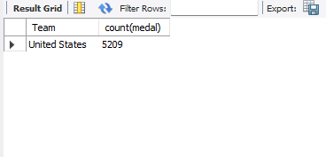
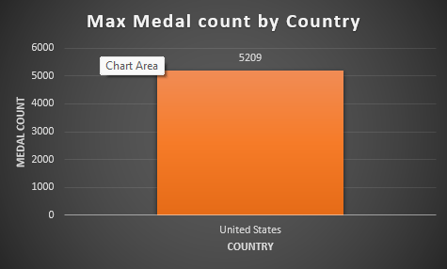
-- 6. show country who won maximum medals.
select Team , count(medal) from Olympic
where Medal!= 'NoMedal’
group by Team
order by count(medal) desc
limit 1;

Slide 9
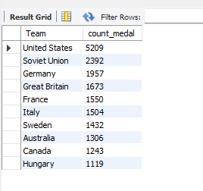
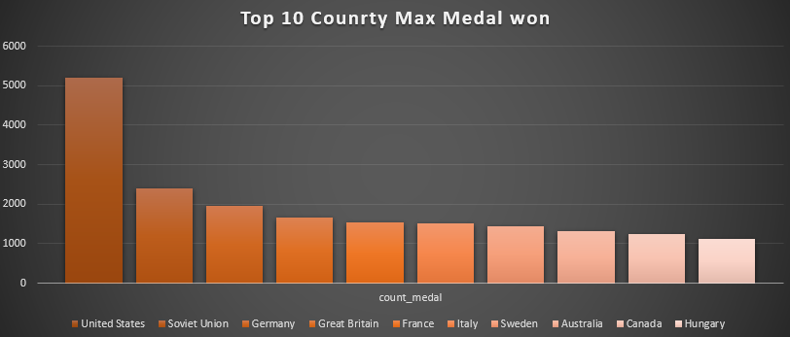
-- 7.show top 10 countries who won gold Medals
select Team , count(medal) as count_medal from Olympic
where Medal!= 'NoMedal’
group by Team
order by Count_medal desc
limit 1;

Slide 10
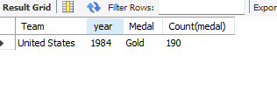
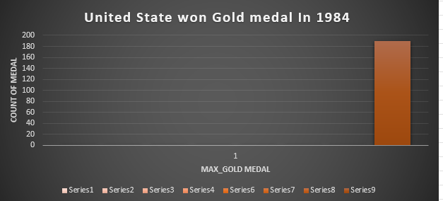
-- 8. show in which year did United states won most gold medal
select Team ,year ,Medal , Count(medal) from Olympic
where (medal='Gold' and Team = 'United States’ )
group by Year , medal
order by count(medal) desc
limit 1;

Slide 11
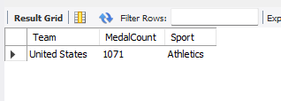
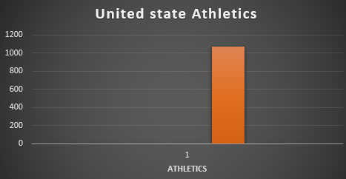
-- 9. In which sports United States has most medals.
Select Team, Count(Medal) as Medal_Count , Sport from Olympic
where (Team = 'United States' and Medal<> 'NoMedal’)
group by Sport
order by Medal_Count desc
limit 1;

Slide 12
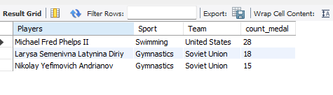
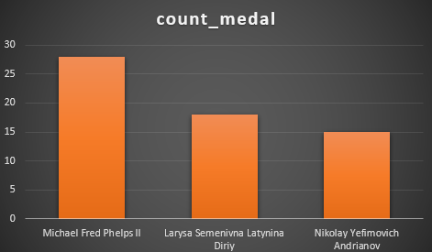
-- 10. Find top three players who won most medals along with their sports and country
Select Name as Players , Sport , Team, Count(Medal) as count_medal from Olympic
where (medal<> "NoMedal" )
Group by Players , Team, Sport
order by count(Medal) desc
limit 3;

Slide 13
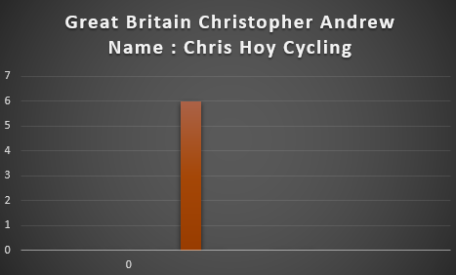
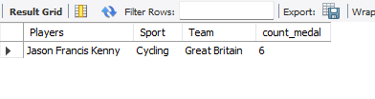
-- 11. Find player with most gold medals in cycling along with his country.
Select Team,Name as Players,Sport,Count(Medal) as count_medal from Olympic
where ( Medal= "Gold" and Sport="cycling")
group by Team ,Players, Sport
order by count(Medal) desc
limit 1;

Slide 14
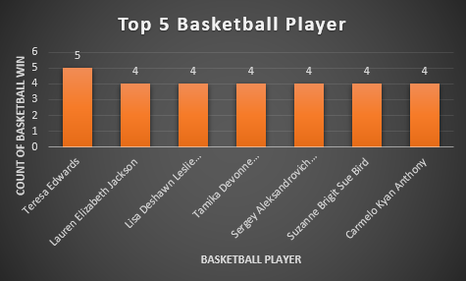
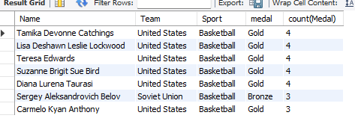
-- 12.Find player with most medals (Gold+Silver+Bronze) in Basketball also show his country.
Select Team , Name, Sport, count(Medal) from Olympic
Where sport = 'Basketball' and Medal<>'NoMedal’
Group by Name , Team, Sport
order by count(Medal) desc
limit 7;

Slide 15
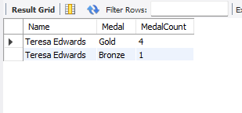
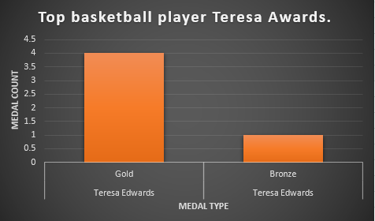
-- Q12. Find out the count of different medals of the top basketball player Teresa Awards.
Select Name, Medal , count(Medal) as Medal_Count from Olympics
where Name = 'Teresa Edwards' and Medal<>'NoMedal’.
group by Medal
order by Medal_Count desc ;

Slide 16
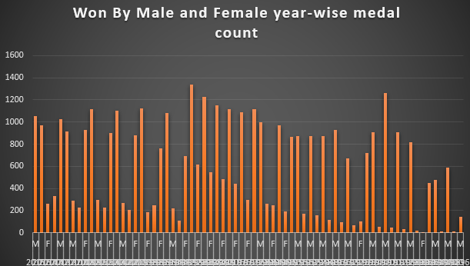
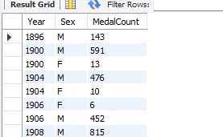
-- Q13. Find out medals won by male,female each year.
Select Year , Sex , Count(Medal) As Medal_Count from Olympics
Where medal<>'NoMedal’
Group by Sex ,Year
order by Year asc;

